Slide 1
Exploratory Analysis of Mesa County Public Health
By Kurtis Bulock

Slide 2
Observations
Representation of Race Survey vs. County.
Loneliness vs. Social Conflict:
All ages
Children
Household Income vs. Household Danger.
Household Income vs. Social Conflict.
Future Work
Possible continued observations.
How this information can be used for future action.
Notes:
4 observations
And possible Future work

Slide 3
Racial Representation (single race)
Race | Survey Representation | County Representation
Asian | 0.742% | 1.036%
Black/African American | 1.372% | 0.948%
Native American/Alaska Native | 5.193% | 1.534%
Native Hawaiian/Other Pacific Islander | 0.297% | 0.137%
White | 92.40% | 93.94%
Native American/Alaska Natives overrepresented
Other races are nearly accurately represented
Notes:
The representation appears fairly accurate except for one standout, Native American/Alaskan people are overrepresented by over 3.5%

Slide 4
Racial Representation Future Work
Educate the public on minorities in the community.
How does the diversity of CMU compare to the rest of the County?
How does diversity in Mesa County compare to other Colorado counties?
Notes:
This information can be used to help educate the public of the diversity in our county. It’s important to know the people that make up out community.
(mention college/diversity on campus) diversity compared to CMU
How do we compare to the rest of the state?

Slide 5
Loneliness and Social Conflict
Loneliness is reported by Supplemental Need Family & Community Support Question.
Loneliness is measured on the following scale:
[0] NEVER
[1] RARELY
[2] SOMETIMES
[3] FAIRLY OFTEN
[4] ALWAYS
Social Conflict is measured out of a total of 16 by adding all the Core Need Safety Questions: 1-4.
CN_SF_1-4 are measured by the following scale:
[0] NEVER
[1] RARELY
[2] SOMETIMES
[3] FAIRLY OFTEN
[4] FREQUENTLY
Notes:
Next observation we’ll be looking as is the relationship between Loneliness and Social Conflict
Loneliness measured on a scale 1-4
Social Conflict is based on the sum of all 4 Core need Safety questions

Slide 6
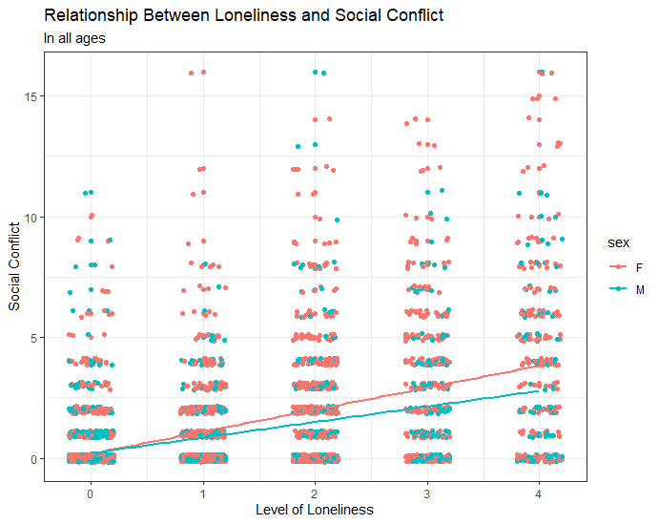
Loneliness and Social Conflict
Higher social conflict correlates with a higher feeling of loneliness
Reporting higher loneliness in women
Notes:
Loneliness trends upward for all ages, when confronted with more social conflict.
Women report even higher than men

Slide 7
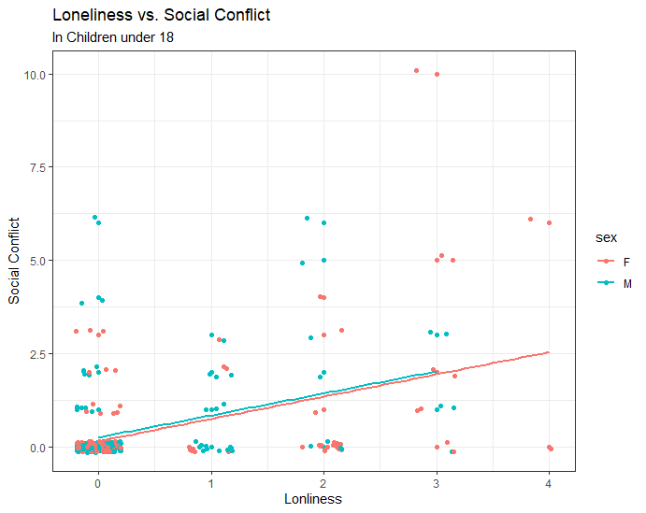
Loneliness and Social Conflict in Children
Similar trend in children
Data pool much smaller
Notes:
In the same chart for children we can see a similar trend
However, the data pool is much smaller for children reporting this statistic. So more data may be required to get an accurate measurement

Slide 8
Loneliness and Social Conflict Future Work
Loneliness impact on mental health.
Better recognize social conflict’s affect on mental health.
Can machine learning techniques be applied to accurately predict loneliness in individuals?
Notes:
If I continued, I would be interested in finding the relationship between Loneliness and mental health within an individual
]
These measuremnets might be able to hel;p better recognize how social conflict affects mental health
Could a machine learning model be applied to predict loneliness in an individual? That be useful for examining the public health

Slide 9
Household Income and household dangers
Income reported by Tell Me About Yourself: Question 6
LESS_THN_10K;
MORE_THN_10_LESS_THEN_15K
MORE_THN_15_LESS_THEN_20K
MORE_THN_20_LESS_THEN_25K
MORE_THN_25_LESS_THEN_35K
MORE_THN_35_LESS_THEN_50K
MORE_THN_50_LESS_THEN_75K
MORE_THN_75K
Household Danger measured by Core Need Living Situation: Question 2
Do you have problems with…? [0] No, [1] Yes, [7] Total
Bug Infestation
Mold
Lead Paint
Inadequate Heat
Oven (not Working)
Smoke Detector (not Working)
Water Leaks
Notes:
Income measures as low as $10K to more than 75K
Household danger measured by the sum of all Core Need Living Situations Questions

Slide 10
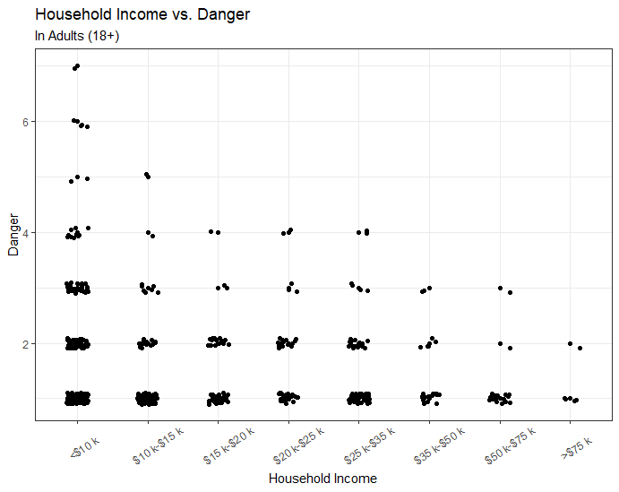
Household Income and Household Dangers
Less Income = More Danger
Intuitive conclusion
Notes:
You can tell from this chart, there is an obvious inverse relationship between these two variables
This may be intuitive because less money creates less support to provide for basic needs

Slide 11
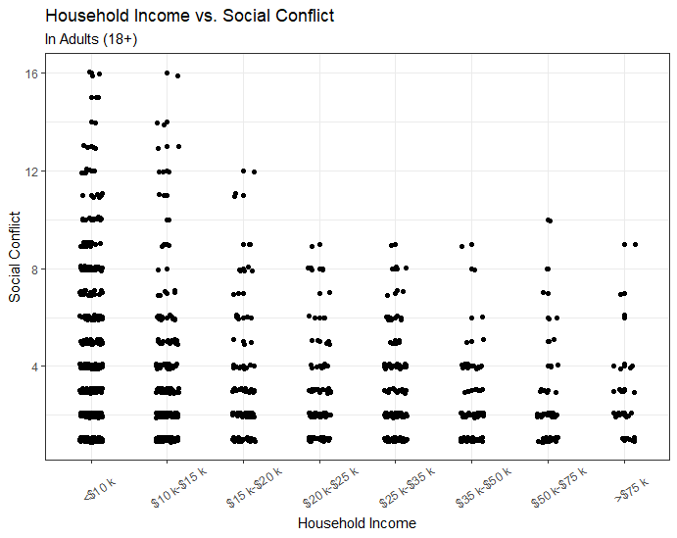
Household Income and Social Conflict
Less significant correlation
Plateaus after $20k
Notes:
I wanted to see if income had any affect on social Conflict
More money appears to lead to less conflict, however it is much less significant than household danger

Slide 12
Household Income Future work
Income can be a factor in overall individual health. (Food/Transportation/Housing)
Identify low income populations to better employ social services
Notes:
Income could be a factor in the health of the individual. Low income populations will likely struggle more with Core needs like food transportation or housing
If we could better identify low income populations, it might allow us to employ needed social services more effectively

Slide 13
Tools / Resources
Tools
R/Rstudio
Ggplot2
Tidyverse
Dplyr
Knitr
Excel
Resources
Interview_data.csv (Raw Data)
Interview_data_dict.csv (Data Dictionary)
Accountable Health Communities Model Screening Tool.docx (Survey)
www.Census.gov (Mesa County Population estimates)
Notes:
Tools and Packages
How each resource helped this presentation

Slide 14
Rmarkdown / Github
Similar presentation written Rmarkdown for reproducibility
Download or view all code at https://github.com/kurtisbu/Mesa-County-Data
Notes:
Wrote presentation in an Rmarkdown file. This allows for better reproducibility; however, it isn’t nearly as pretty.
You can view/download the markdown file, and all other files involved with this presentation in my get hub Repository at this address

Slide 15

Thank you
Questions?

